Slide 1
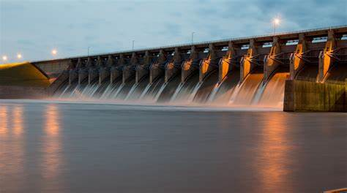
A Convergence of Issues for
Northwest Hydropower
Then, Now and What’s Coming Next

Slide 2
What is the purpose of today’s discussion?
Inform
  Despite recent policy and market successes, hydro is facing headwinds
  Our traditionally “good news” messages are being countered
  Pending policies could threaten hydropower’s regulatory status, and market position
  Fast-moving initiatives and agency policies could be a net positive/net negative for hydropower – creating uncertainty and opportunity
  Changes are converging in the Northwest, particularly with the federal hydropower system’s lower Snake River Dams
  The treatment of the LSRD is a bellwether issue for hydropower across the country
Prepare NHA to respond when appropriate
Discuss
No decisions/actions today

Slide 3

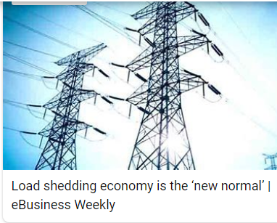
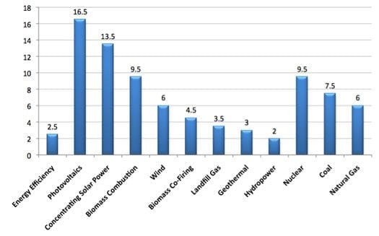
Then: Hydropower is affordable
Now: Affordability is less important than other policy goals

Slide 4
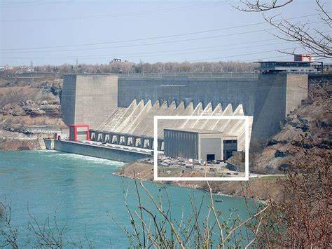
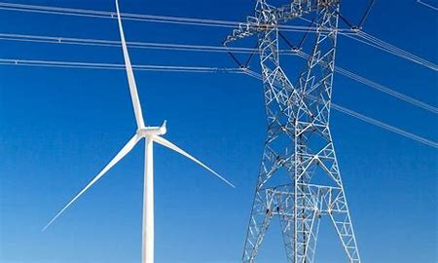
Then: Build on existing infrastructure
Now: Build new technologies and new transmission

Slide 5
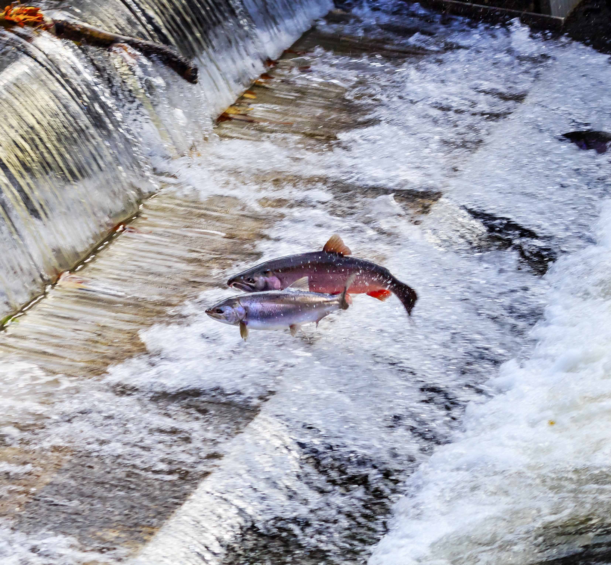
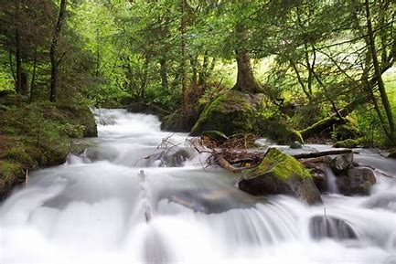
Then: Mitigation programs where fish and hydro coexist
Now: Dam removal, unattainable WQ standards

Slide 6
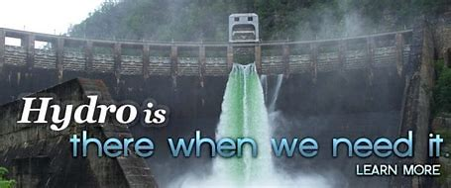
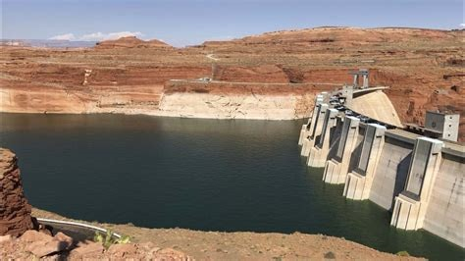
Then: Hydro is Reliable
Now: Hydro is threatened by drought

Slide 7
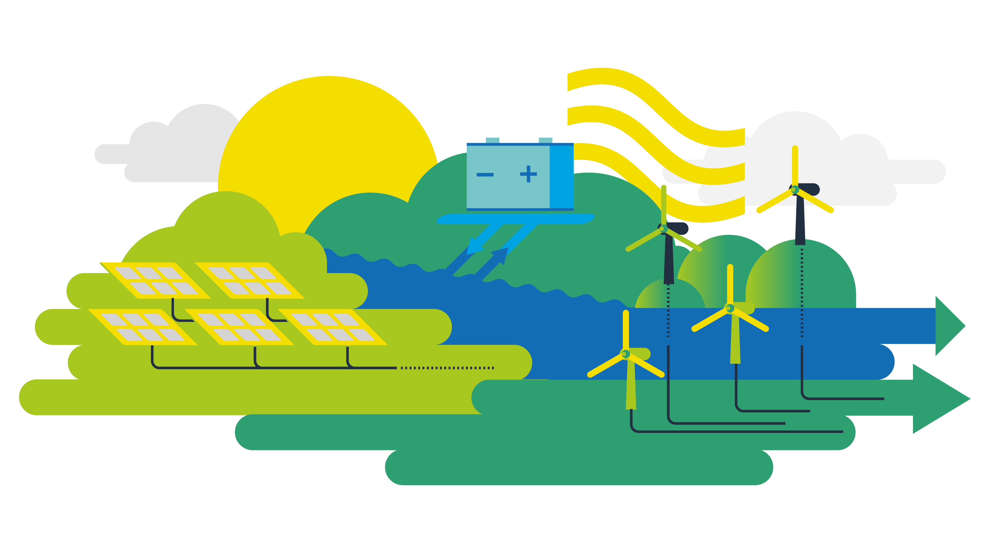
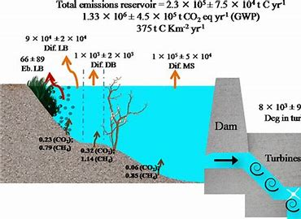
Then: Hydro is carbon free
Now: Hydro has reservoir emissions

Slide 8
Positive for Hydro Opportunity/Risk Likely Negative
Energy, capacity and attribute markets Clean Energy Transformation Act (CETA), Washington Hydro incentives IIJA Hydro incentives (Tax) | Relicensing Permitting reform Uncommon Dialogue Federal funding for dam removal Columbia River Treaty BPA F&W Program Reintroduction Federal funding for habitat conservation, related programs NEPA climate guidance | Federal mediation process Lower Snake River Dam Removal EPA reservoir emissions to UN Unattainable water quality standards Mandatory prescriptions Environmental Justice FERC Office of Public Participation Scope of 401 (unknown legal) Tribal Indigenous Knowledge, general changes around tribal participation

