Slide 1
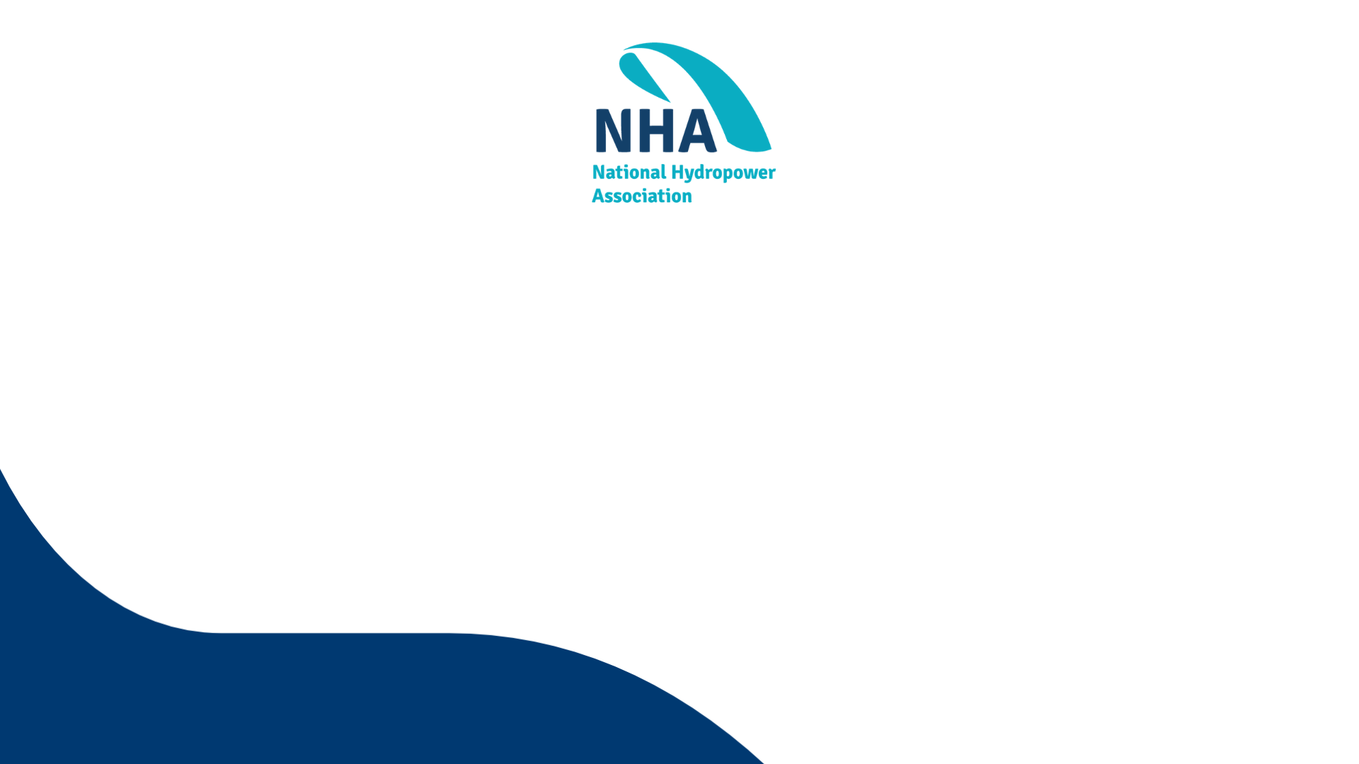
Item 12: How to Scale Our Markets Advocacy Efforts
Mike Purdie – Director of Regulatory Affairs
and Markets

Slide 2

Background
Approximately 2/3 of the country exists in organized markets.
  Regions outside organized markets are increasing collaboration as renewable penetration increases (i.e., SEEM, CAISO EIM/EDAM, SPP Markets+, etc.).
Historically, NHA’s input into market rule changes has been narrow and targeted.
NHA also does not believe that a “one-size fits all” market design will ever take hold.
NHA has operated a clearinghouse at the Markets Committee as a way to share information across regions.
  “Connect” and “Inform” with targeted “advocacy” via pleadings to the FERC or state level dockets.

Slide 3
Opportunity Going Forward?
Many asset owners have a broad portfolio of supply (and load interests) and have to properly balance their advocacy accordingly.
Each region has its own stakeholder processes and market designs.
  There appears to be a real need in some regions for NHA to take an active advocacy position on behalf of hydropower, while recognizing resource constraints.
How do we get NHA to be seen as a valuable tool both to NHA members and outside entities as an important entity in this space?

Slide 4
Options for Board Consideration
Option 1: Status Quo
  NHA continues the Markets Committee as a clearinghouse.
  Where issues arise that NHA targets or members bring to NHA, NHA then advocates via a pleading.
  Member led caucuses.
  Pros: bottom-up process, limited budget impact.
  Cons: NHA is, at most, a complement to advocacy already occurring.
Option 2: Targeted RTO/ISO Stakeholder Engagement
  Option 1 but with targeted engagement in one or two RTOs.
  Pros: NHA is a stakeholder and can advocate for market rule changes at the ground level as opposed to late in the process at the FERC or in a state docket.
  Cons: Budget and/or FTE impact. Could be difficult getting all members in that region to agree on a design change.
Option 3: Market Policy Thought Leader
  Same as Option 1 and/or Option 2, but focuses more on developing market designs and partnering with external parties (e.g., other associations, certain companies, etc.).
  Would require market participants to bring the designs to the respective stakeholder bodies.
  Pros: Limited FTE impact.
  Cons: “Boiling the ocean”? In each region? Potentially high outside consultant budget.

Slide 5
Thank You!
Michael Purdie
Michael@hydro.org

