Slide 1
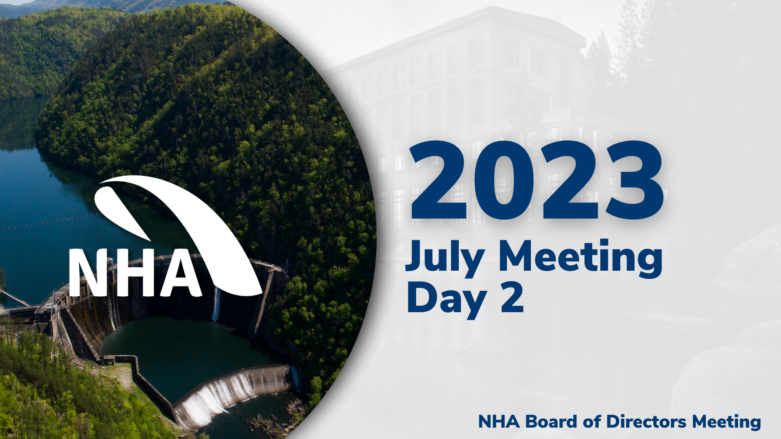

Slide 2


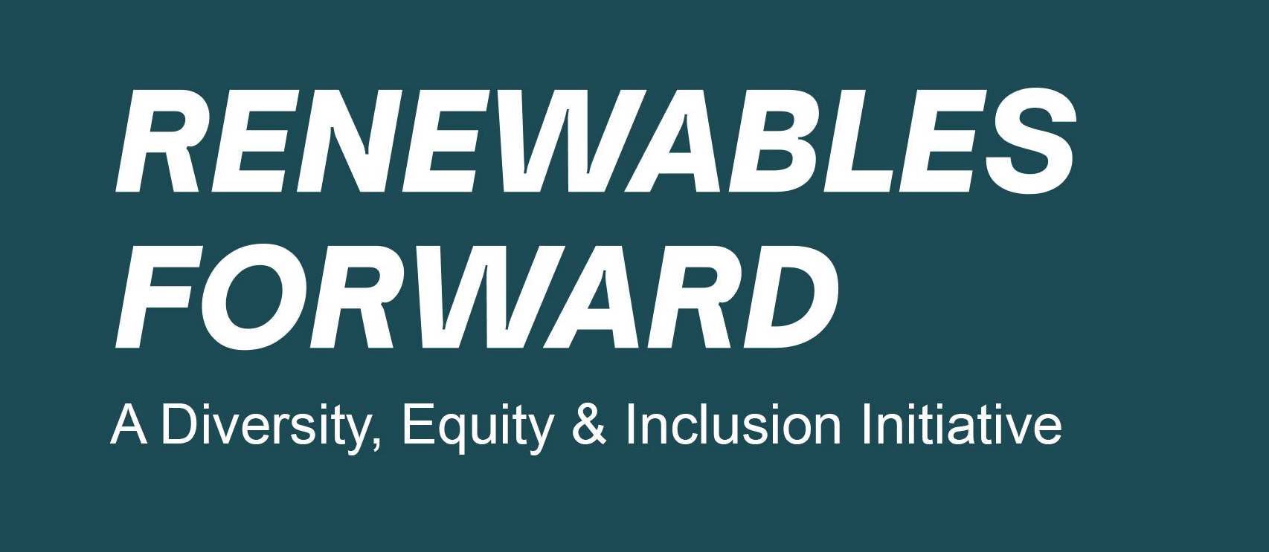

Thriving in a new Business Era
RENEWABLES FORWARD
National Hydropower Association
July 18, 2023

Slide 3
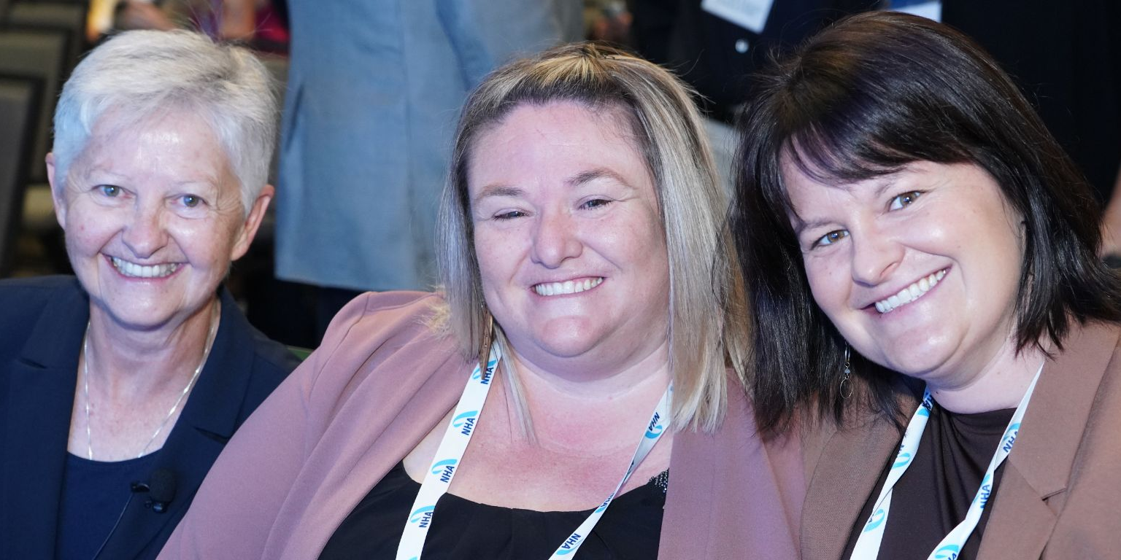
Hydropower: Shape Your Future
NHA By-Laws and policies support growth through diversity:
Building a platform and inviting emerging voices from historically excluded communities, including people who are Black, indigenous, people of color, women, veterans, LGBTQIA+, young professionals, and/or have disabilities.
Hosting panels and workshops that encourage and train organizations to create environments that are safe, welcoming, and supportive of diverse perspectives.
Recruiting leaders from different backgrounds whose expertise will guide our industry towards a more diverse and sustainable future.
Partnering with communities most affected by waterpower initiatives for their benefit and the success of the work
Renewables Forward offers:
Collaboration
Best Practices
Access to Federal resources
Workforce pipelines and Training

Slide 4
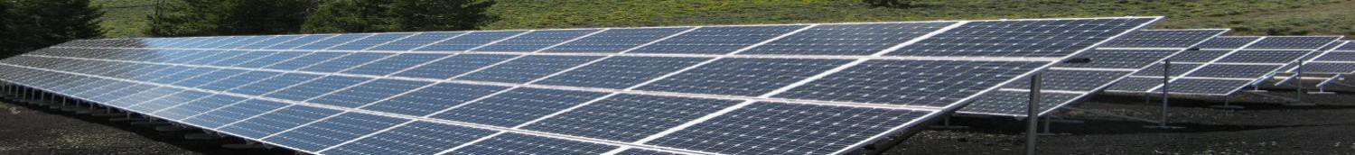


Who We Are
Renewables Forward is driven by the commitment of C-suite leaders to ACTION for DEIA within the clean energy industry.
    Hydropower
    Solar
    Wind
    Energy Storage
    Energy Efficiency
    NHA is a solid Member – Let’s work together!
February 25, 2021 | Strictly Private & Confidential |
3

Slide 5
Why “Workforce”?
More than 1 Million new workers
needed in the clean energy industry
by 2032
Every level of professional needed!
Entry
Mid-Career
Transitioning from other Industries
Senior managers
Vice--President and C-levels needed
What is “Equitable Workforce” development?
IRA Solar Job Impacts – est.
Source: Impact of the Inflation Reduction Act factsheet, 2022: , SEIA analysis based on data from Wood Mackenzie, IREC National Solar Jobs Census
Equity | Equality
Offering everyone opportunities that recognize and adjust for a baseline of foundational experiences | Treating everyone the same
A diverse organization isn’t automatically an inclusive one
An inclusive organization isn’t automatically an equitable one
Notes:
. For those unfamiliar with what "equitable workforce development” is–
What are good starting points for developing a robust workforce program?
Are there concerns when you’re thinking about workforce beyond the normal concerns for growth?
3. Stabilized costs; nuance here – we might want to touch on why/how each projects got started with workforce
ii. What is a meaningful level + impacts for community + customers? How did your organization determine pathway to greater workforce?
iii. What kinds of mechanisms and ownership models allowed you to provide a workforce program?

Slide 6
Level Setting: DEIB definitions
Diversity - collection of unique attributes, traits, and characteristics that make up an individual
Equity – conditions that set a level playing field (historic and present day) to offer all individuals a just and fair chance to be successful
    Recognizing that we all start at different points.
Equality - treating everyone the same
Inclusion - the degree to which an employee perceives that they’re a valued member of the work group and encouraged to fully participate in the organization.
Accessibility – Who gets in, and how? Financial, cultural, physical, emotional, and structural conditions that set a foundation for individuals to enter an organization, career, training system or community, recognizing all human conditions (race, ability, gender, ethnicity, sexual identity, class, etc.)
AND: Belonging – A culture or feeling that provides a sense of security, safety, and acceptance for a member within a certain group.

Slide 7
Mission
The transition to an economy powered by clean energy is under way.
We commit to action that elevates training and education, opens access to networks and resources, shares and builds wealth for the communities in which we work, and elevates opportunities for every individual and community.
Together, we will build a more resilient, equitable, sustainable and affordable clean energy future.
Renewables Forward supports all clean energy organizations: solar, wind, hydropower, storage and efficiency.
Framework Principles:
Assess diversity, equity and inclusion in our industry to raise awareness around inequality and benchmark progress toward a more diverse, equitable, and inclusive industry;
Develop and share corporate practices and policies for a consistent drive toward increasing diversity, equity and inclusion within our companies and the industry;
Create a more diverse and inclusive pipeline of candidates for careers in the renewable energy industry; and
Invest in the under-resourced and minority communities in which we work.
February 25, 2021 | Strictly Private & Confidential | 4

Slide 8
Member Benefits
The Renewables Entrepreneur-Executive Partnership (REEP) Program
9-month Exec-Entrepreneur Program
Sponsor up to 25 Woman and BIPOC-owned start-ups, with training & support
Commitment: 14-20 hours over 9 months
Program year 1: Sept 2022 - April 2023
Program year 2: Sept 2023 - April 2024
DEI Playbook & Action Guide
Comprehensive tools to start or enhance DEI journey
Links to webinars and training resources
Job board postings and job fairs to recruit candidates from diverse backgrounds
DEI Evaluation & Deep Dive
Company evaluation and DEI planning with RF staff
Participation in Member Match small groups of similar RF companies for safe discussion, support and feedback
Jointly leverage philanthropic efforts
Access to the Resource Library
Measuring Access & Increasing Accountability
CEO Challenge Summit (2/yr): Advising national policies and CEO commitments
Benchmarking of empirical DEI objectives
DEI Icon for Member websites showing progress
Listing in our online directory and logo representation on our website
February 25, 2021 | Strictly Private & Confidential |
11

Slide 9
Access, Collaboration
Renewables Forward connects NHA to…
American Clean Power
Solar Energy Industries Association
American Council on Renewable Energy
- Plus -
US Department of Energy (staff, resources)
US Department of Labor (connecting employers with RA)
USDA staff and resources
DOE National Labs (research, technical support)
BIL & IRA funds and training

Slide 10
Next Steps
Discuss NHA member needs; prioritize actions
Decide how to engage in fruitful collaboration for…
  Workforce initiatives founded on DEI principles
  Elevating the career benefits of hydropower
  Training and exploration of inclusive organizations
February 25, 2021 | Strictly Private & Confidential | 18

Slide 11


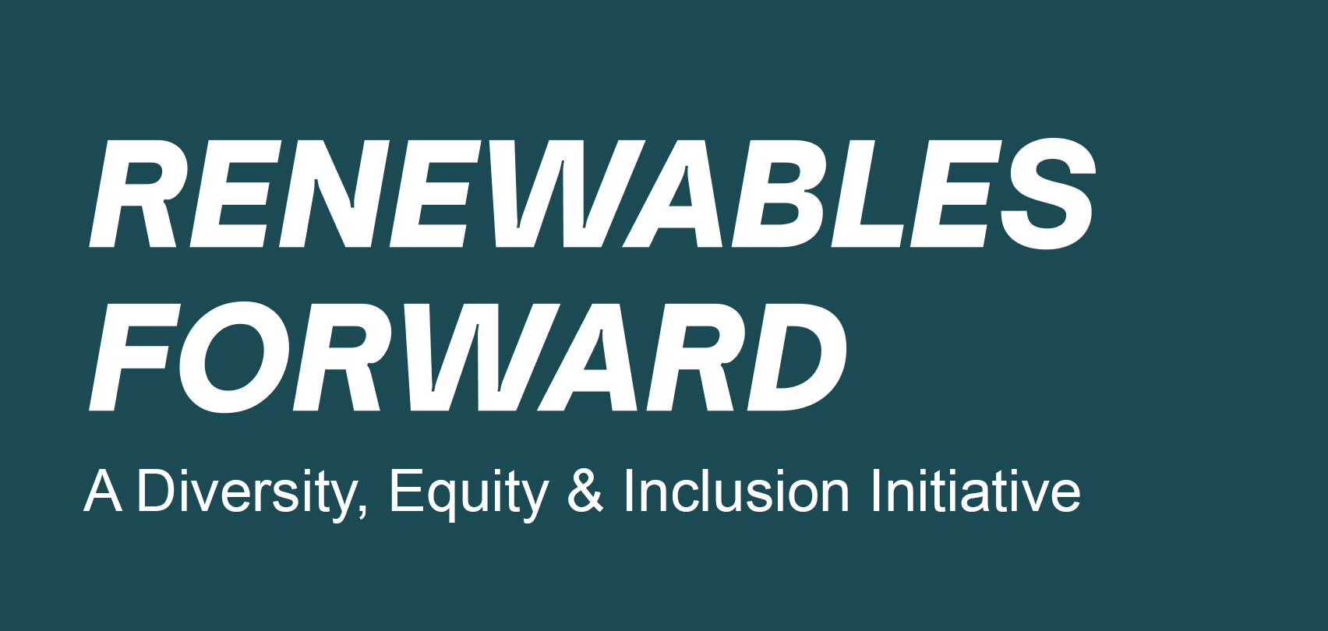

Discussion

Slide 12















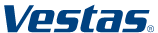




















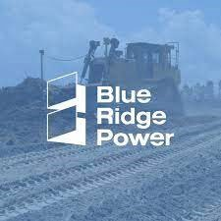



Members – updated monthly with add’l members
SouthPoint & Co.

Slide 13

NHA Board of Directors Meeting
July 17-18, 2023
Reinvigorating NHA’s Technical Programming
HTC Update & Educational Opportunities

Slide 14

HTC Update
Activities launched since March 2023:
Lunch and Learns (1 x month)
  Transformer Fire, Condition Monitoring, OpEx, Oils and Greases etc
Building technical depth via member engagement
Benchmarking opportunities (operations/water quality)
Notes:
Was asked by current WIC leadership to provide an assessment of what is in WaRP and what conclusions we reach to move it forward.

Slide 15
HTC Update
Activities launched since March 2023:
Asset Owner Forums (1 x Quarter x sub group)
  CDSE Roundtable (June 15, July 28)
  O&M (July 18)
  Senior Leaders (May 19)
Notes:
Was asked by current WIC leadership to provide an assessment of what is in WaRP and what conclusions we reach to move it forward.

Slide 16
HTC Update (Cont’)
Opportunistic/ Responsive Training/Workshops, held either virtually or co-located with NHA regional and/or national events:
Two Hydro Academy Workshops held at Waterpower Week – May 10:
  Tools of the Trade: Skill-Building and Applications for Negotiations Techniques
  Applying for U.S. Department of Energy Funding: From Application to Award Management
FERC Dam Safety Part 12 Virtual Training – May 18
Lunch and Learns
- Clean Currents Workshop Offerings
Notes:
Was asked by current WIC leadership to provide an assessment of what is in WaRP and what conclusions we reach to move it forward.

Slide 17

Educational Opportunities
Three key questions for today:
What are we doing now?
What is the gap?
Why is NHA uniquely positioned?
Industry Needs – results from listening "tour"
Next Steps
Discussion / Q&A
Notes:
Was asked by current WIC leadership to provide an assessment of what is in WaRP and what conclusions we reach to move it forward.

Slide 18
Industry Needs – Gleaned from Listening Tour
There are several influencing factors in play:
Aging workforce and assets, erosion of technical expertise, new technologies, changing grid, budget constraints.
Hydro Industry needs professional development/continuing education for employees on a variety of topics, both technical and "soft" skills.
Formal and Proactive wide-ranging Hydro 101 Course, with a completion certification component
Notes:
Was asked by current WIC leadership to provide an assessment of what is in WaRP and what conclusions we reach to move it forward.

Slide 19
Why is NHA Uniquely Positioned?
There are several influencing factors in play:
1) Access to NHA membership base, leverage best in class expertise, tailor appropriate subject leaders to respective training areas.
2) Unique offering; 1 stop shop / 360-degree coverage
Production Planning and Water Management
Dam Safety
Equipment Reliability
Asset Management
Markets
Environment
Notes:
Was asked by current WIC leadership to provide an assessment of what is in WaRP and what conclusions we reach to move it forward.

Slide 20
Industry Needs (Cont)
Additional topics of interest could include:
Hydro 201/301 level courses for SMEs
Hydropower Training for executives (new to hydro and coming over from nuclear, thermal etc)
Licensing and License compliance training
Notes:
Was asked by current WIC leadership to provide an assessment of what is in WaRP and what conclusions we reach to move it forward.

Slide 21
Next Steps
Establish an ad-hoc group of Board members to guide/advise on:
  Overall Concept
  Curriculum Development*
  Budget
  Fee structure
Bring firm plan to Board in October 2023 for approval.
Notes:
Was asked by current WIC leadership to provide an assessment of what is in WaRP and what conclusions we reach to move it forward.

Slide 22
Discussion and Q&A
Other items to consider?
Sub-group volunteers?
Schedule?
Notes:
Was asked by current WIC leadership to provide an assessment of what is in WaRP and what conclusions we reach to move it forward.

Slide 23
Content Development/Execution
Hydro 101 Course
Curriculum delivered over 12 months
Virtual Delivery, perhaps supplemented with 1 or 2 in-person sessions tied to regional meetings or national conferences
Course Title: "Hydropower System Principals" covering:
Production Planning and Water Management
Dam Safety
Equipment Reliability
Asset Management
Markets
Environment
Notes:
Was asked by current WIC leadership to provide an assessment of what is in WaRP and what conclusions we reach to move it forward.

Slide 24
Course Budget Considerations
Items to be considered include:
Curriculum Development
Marketing/Awareness Campaigns
Logistics and Content Delivery Tools/Methods
Staffing
Certification Capability
Notes:
Was asked by current WIC leadership to provide an assessment of what is in WaRP and what conclusions we reach to move it forward.

Slide 25
Funding Models
Potential ideas to consider:
Increase existing NHA membership dues to account for new service to be available for all members
Membership Training Service option:
  Flat fee opt-in model for your organization
  Dues structure could be tiered to factor organization size
Notes:
Was asked by current WIC leadership to provide an assessment of what is in WaRP and what conclusions we reach to move it forward.

Slide 26
NHA Board of Directors Meeting
July 17-18, 2023
Rolling Out the new Op-Ex On-Line Resource Tool

Slide 27


Demonstration
Messaging
Roll Out Schedule
Event Report Submissions
Discussion / Q&A

Slide 28
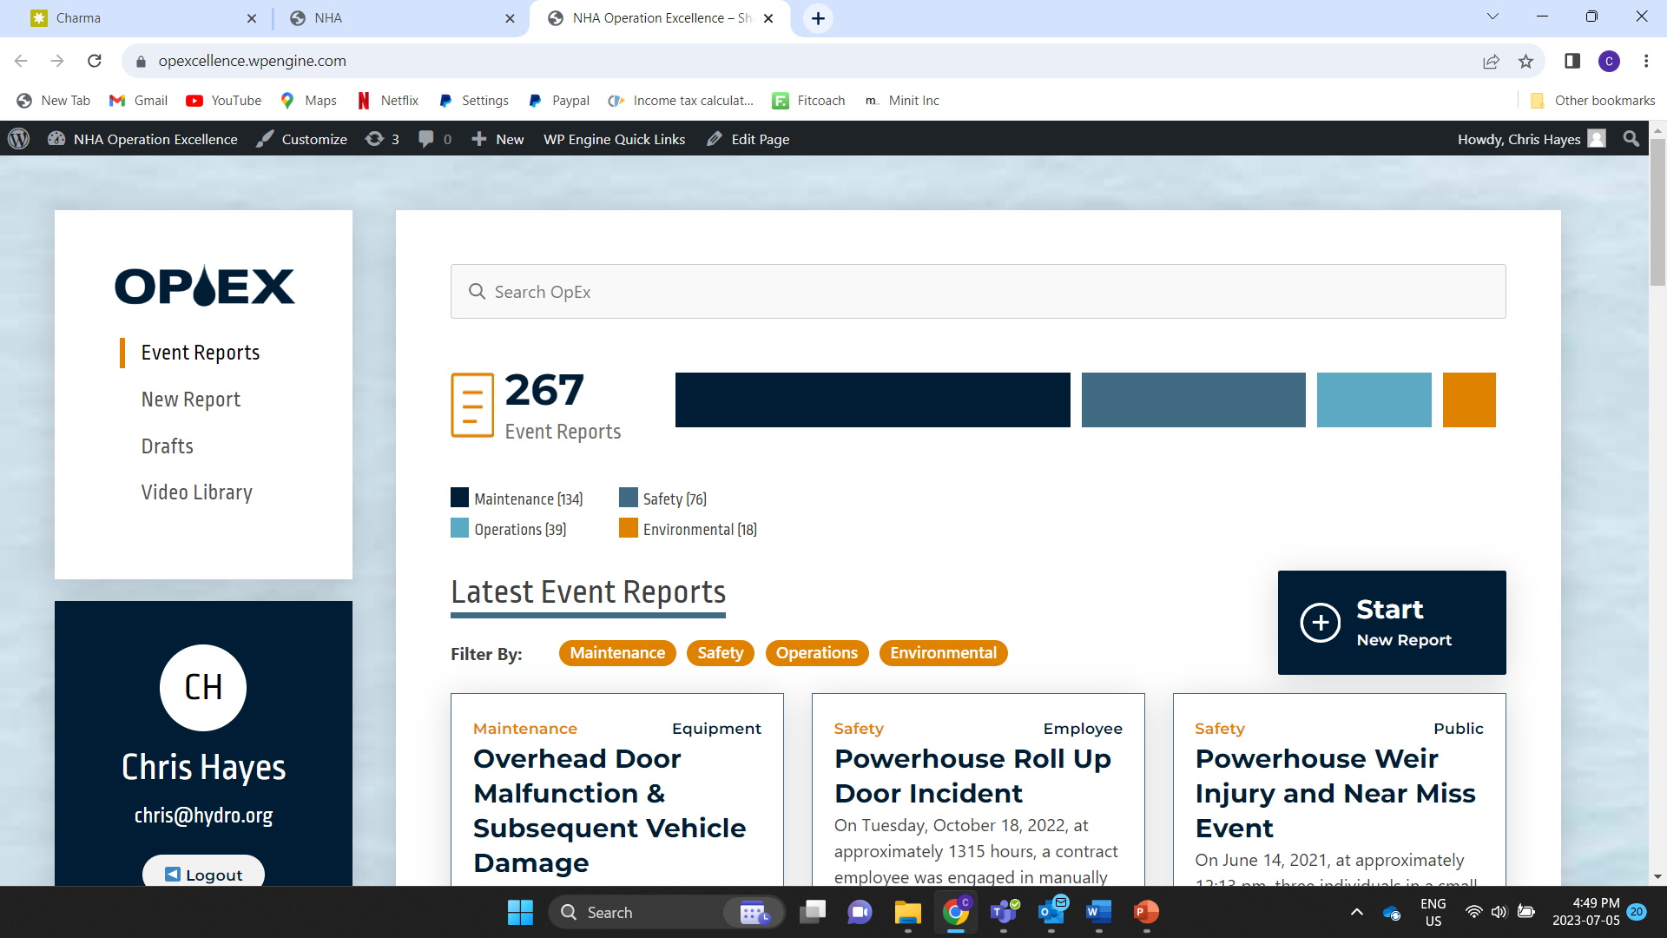
Demonstration https://www.hydro.org/opex-operational-excellence/#login
Notes:
Was asked by current WIC leadership to provide an assessment of what is in WaRP and what conclusions we reach to move it forward.

Slide 29
Results to Date
These Event Reports contain over 1,100 lessons learned and corrective actions
Human Performance was a factor in 48% of the events.
Notes:
Was asked by current WIC leadership to provide an assessment of what is in WaRP and what conclusions we reach to move it forward.

Slide 30
OpEx Event Reports CY 2022
National Hydropower Association
OpEx Event Reports CY 2022
Counts By Company & Category
 | Category
Company | Environmental | Maintenance | Operations | Safety | Total
Chelan County PUD |  | 1 |  | 3 | 4
Duke-Energy | 1 |  |  | 2 | 3
Pacific Gas & Electric |  | 2 | 4 | 4 | 10
WECC Energy Group |  | 2 | 1 | 2 | 5
Yuba County Water Agency | 1 | 2 |  |  | 3
Total | 2 | 7 | 5 | 11 | 25
Notes:
Was asked by current WIC leadership to provide an assessment of what is in WaRP and what conclusions we reach to move it forward.

Slide 31
OpEx Event Reports CY 2023
 | Category
Company | Environmental | Maintenance | Operations | Safety | Total
American Municipal Power (AMP) |  | 2 |  |  | 2
Chelan County PUD |  | 1 |  | 2 | 3
Northwestern Energy |  |  |  | 2 | 2
Pacific Gas & Electric |  |  |  | 1 | 1
WECC Energy Group |  |  |  | 1 | 1
Total | 0 | 3 | 0 | 6 | 9
Notes:
Was asked by current WIC leadership to provide an assessment of what is in WaRP and what conclusions we reach to move it forward.

Slide 32
Messaging – Value of using the tool
LET THE NEW OPEX RESOURCE TOOL WORK FOR YOU!
Trouble-shooting an operational issue?
Preparing for an “in the field” maintenance project?
Developing corrective actions to ensure worker safety?
Seeking environmental-related lessons learned?
Looking for content for your daily safety moment?
https://www.hydro.org/opex-operational-excellence/
Notes:
Was asked by current WIC leadership to provide an assessment of what is in WaRP and what conclusions we reach to move it forward.

Slide 33
Awareness Campaign
Milestones
Information page on hydro.org – complete - https://www.hydro.org/opex-operational-excellence/
June lunch and learn - complete - https://www.hydro.org/opex-operational-excellence/#VideoLib/
Inform member organizations about availability of new tool – starting August 2023
  NHA Member Playbook articles
  Direct email communications to relevant committees / councils
  Announcements at member-only meetings – (e.g., asset owner forum)
  Webinar tutorial to demonstrate tool
  Announce new event reports, via direct email with a PDF of report
Raise awareness among industry about value of tool, which is part of NHA membership – starting July 2023
  Amplification at NHA national and regional events
  POWERHOUSE Article
Notes:
Was asked by current WIC leadership to provide an assessment of what is in WaRP and what conclusions we reach to move it forward.

Slide 34
Call for Event Report Submissions https://www.hydro.org/opex-operational-excellence/#EventReport
How do we incentivize employees of asset owners, as well as service/product suppliers, to submit event reports? Goal is to go from hundreds to thousands
Appeal to "sense of duty" - share your incidents in order to raise the hydropower industry’s standard of performance
Make it easy to submit – if you are already submitting a corrective action report, simply send your internal report to NHA staff and we will put it in the correct form
Get managers to tie submissions to performance requirements
Notes:
Was asked by current WIC leadership to provide an assessment of what is in WaRP and what conclusions we reach to move it forward.

Slide 35
Call for Event Report Submissions https://www.hydro.org/opex-operational-excellence/#EventReport
Challenges to consider:
Personnel bandwidth, capacity, timing?
Legal, statute of limitations?
All of the above?
Notes:
Was asked by current WIC leadership to provide an assessment of what is in WaRP and what conclusions we reach to move it forward.

Slide 36
Discussion and Q&A
Other items to consider?
How to promote usage – example: leverage reports as part of your safety moments
How to increase volume of submissions?
Can members leverage their own event reporting system and forms?
Notes:
Was asked by current WIC leadership to provide an assessment of what is in WaRP and what conclusions we reach to move it forward.

