Slide 1
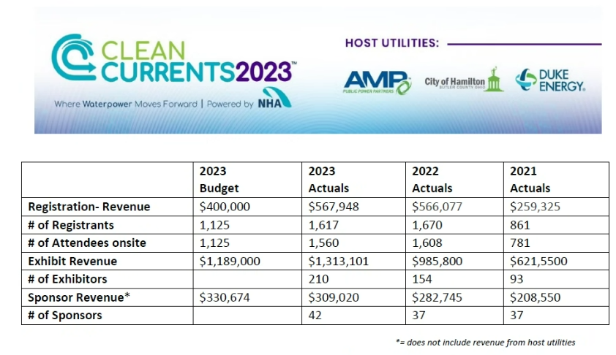

Slide 2
Clean Currents Revenues and Expenses, by year

Slide 3
Clean Currents Net Revenue, by Year

Slide 4
Clean Currents Exhibitors, by Year
220
210

Slide 5
Additional Revenue Growth Opportunities at Clean Currents in ‘24
Attendee Revenue
Sponsor Revenue
~25% of exhibiting companies sponsored something in ’23

