Slide 1
Tax Credits in the Inflation Reduction Act
Beth Hartman, Program Manager for Strategic Innovation and Outreach
Water Power Technologies Office, U.S. Department of Energy
Waterpower Week May 8, 2023

Slide 2

About the U.S. Department of Energy (DOE)
The mission of the U.S. Department of energy is to ensure America’s security and prosperity by addressing its energy, environmental and nuclear challenges through transformative science and technology solutions.
Energy
Catalyze the timely, material, and efficient transformation of the nation’s energy system and secure U.S. leadership in energy technologies.
Science and Innovation
Maintain a vibrant U.S. effort in science and engineering as a cornerstone of our economic prosperity with clear leadership in strategic areas.
Nuclear Safety and Security
Enhance nuclear security through defense, nonproliferation, and environmental efforts.

Slide 3
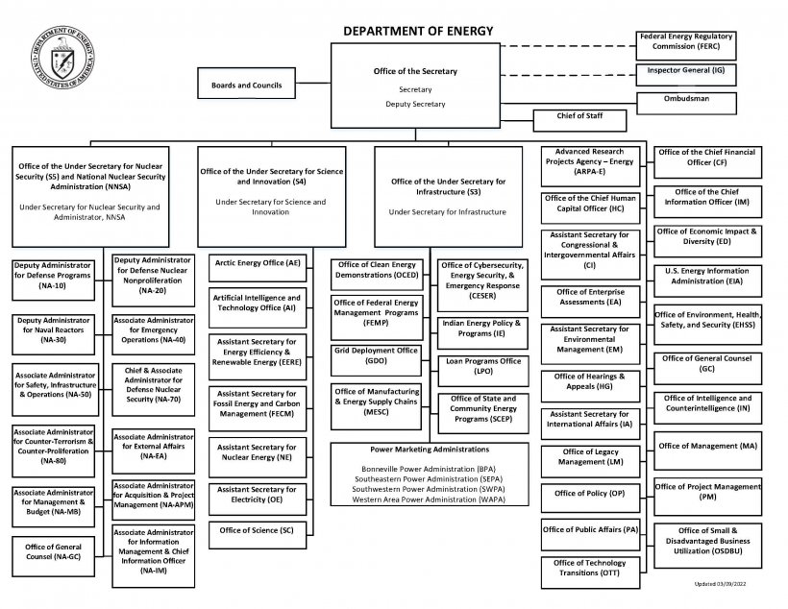
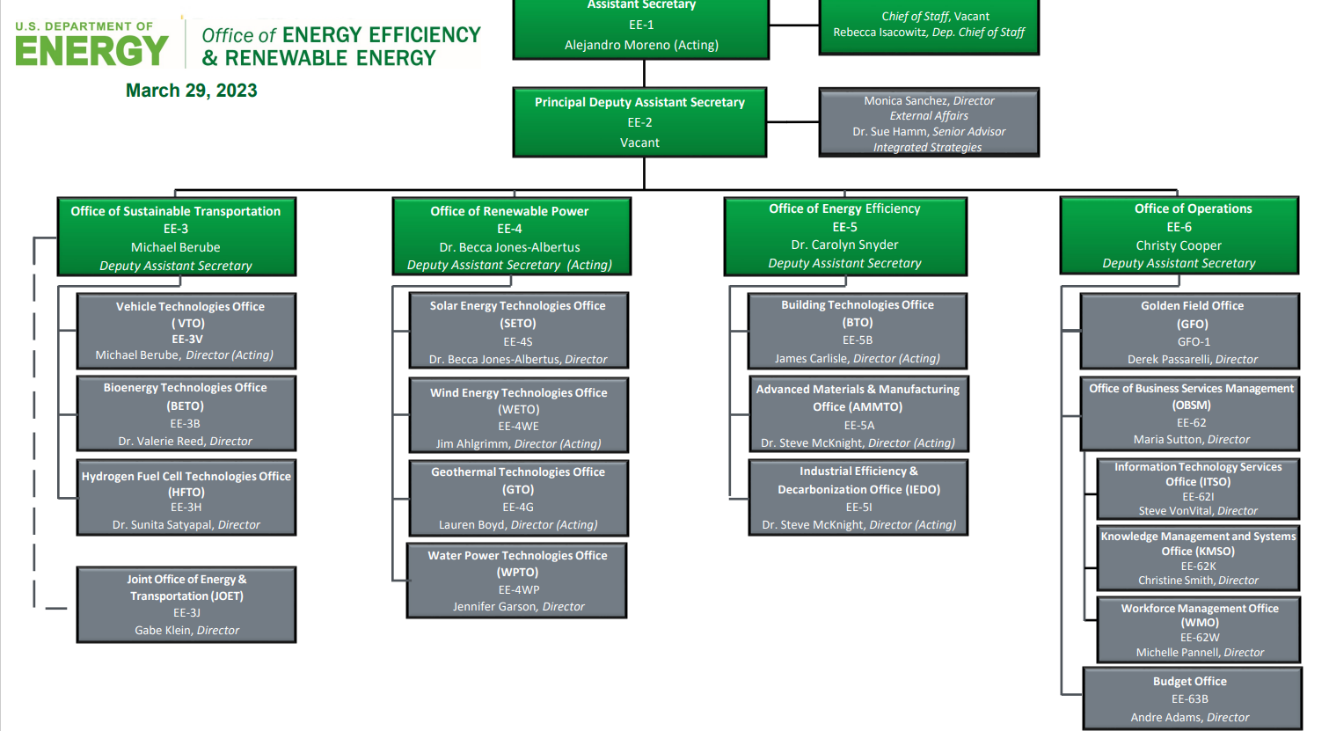
Where is the Water Power Technologies Office?

Slide 4
About the DOE’s Water Power Technologies Office (WPTO)
WPTO enables research, development, and testing of emerging technologies to advance marine energy and next-generation hydropower and pumped storage systems for a flexible, reliable grid.
Modernizing the Existing Fleet
New Low-Impact Projects
Ocean Thermal
Pumped Storage Hydropower
Wave
Tidal, River and Ocean Current
Hydropower Program
Marine Energy Program

Slide 5
WPTO is Interested in Water Power at All Scales
Kilowatts: develop deployable systems to provide clean water, power aquaculture, and powering remote communities
Megawatts: deploy and demonstrate water powered systems for local grids, remote communities, powering dams and agriculture
Gigawatts: deploy and demonstrate seasonal storage, enhance hydro grid flexibility, demonstrate new water power systems
Watts: enable a persistent power source to understand the ocean, by powering observing buoys, monitoring for the environment
All scales require technical and financial assistance, testing infrastructure, user-centric designs, and a robust innovation ecosystem.

Slide 6
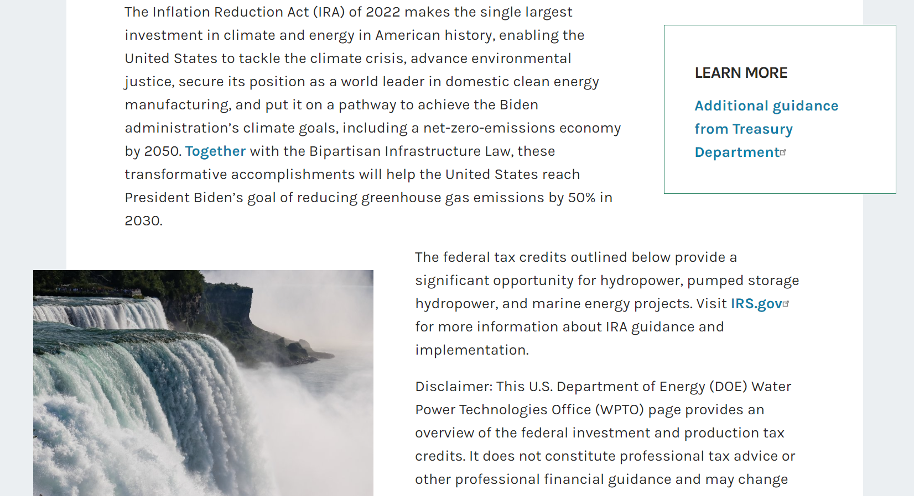
How WPTO Works to Advise Treasury on IRA Implementation
Sending comments directly to Treasury Requests for Information (RFIs)
Coordinating with industry partners to submit RFI comments
Responding to requests for guidance
Providing tools and analysis often in collaboration with national labs
Inflation Reduction Act Opportunities for Hydropower and Marine Energy | Department of Energy

Slide 7

Summary of Major IRA Changes
IRC § | IRA § | Short Name | Major Changes by IRA Enactment
25D | 13302 | Residential Clean Energy Credit | Extended at 30% through 2032. Phases out then expires in 2035. Standalone battery storage now eligible. Biomass heating ineligible.
45 | 13101 | Production Tax Credit (PTC) | $27.5/MWh credit for specific technologies. Solar and geothermal now eligible. Expires in 2025.
45Y | 13701 | Clean Electricity PTC | Similar value 45 credit for zero or negative emitting technologies. Phases out when power sector emissions reach 25% of 2022 levels. Begins in 2025.
48 | 13102 | Investment Tax Credit (ITC) | 30% credit for specific technologies. Storage, biogas, electrochromic glass, and microgrid controllers now eligible. Added allocated low-income bonus of 10-20 percentage points. Expires in 2025.
48E | 13702 | Clean Electricity ITC | 30% credit for zero or negative emitting technologies. Phases out when power sector emissions reach 25% of 2022 levels. Includes allocated low-income bonus of 10-20 percentage points. Begins in 2025.
Cross-cutting provisions (These do not apply to 25D. Covered in detail in other cross-cutting working groups) |  | Wage and Apprenticeship Standards | Projects must meet prevailing wage and apprenticeship requirements for construction, alteration, or repair, otherwise credits are 5x lower
Cross-cutting |  | Energy Community Bonus | Credits are 10% higher for PTC or 10 percentage points higher for ITC if projects are located in an “energy community”
Cross-cutting |  | Domestic Content Bonus | Credits are 10% higher for PTC or 10 percentage points higher if domestic content requirements are met
Cross-cutting |  | Direct Pay and Transferability | Credits are directly paid for non-profits, public power, and government or tribal entities. Otherwise credits are transferable to other taxpayers.

Slide 8

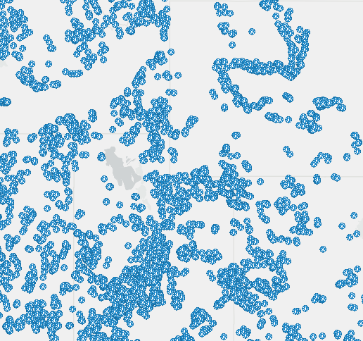
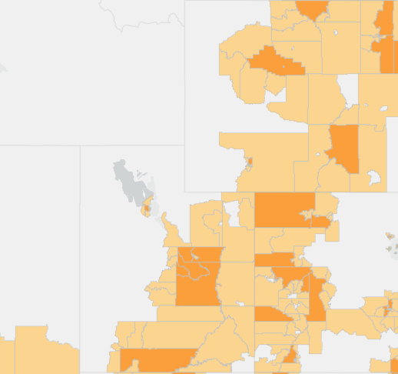
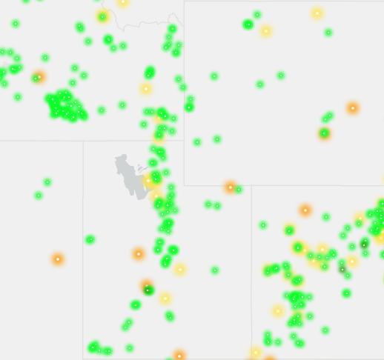
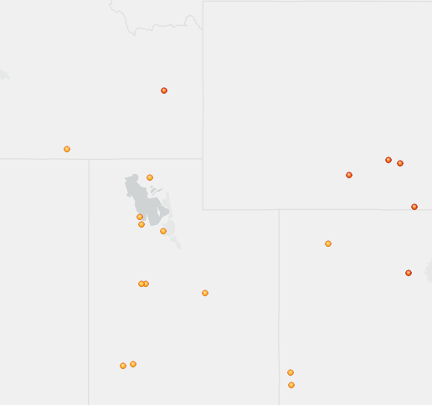
A Forthcoming Tool to Assess IRA Opportunities for PSH
WPTO is funding the Pacific Northwest National Laboratory (PNNL) to develop a new mapping tool that shows the opportunities for high potential, closed-loop pumped storage hydropower (PSH) sites.
PSH planning requires spatial assessment, and IRA sets the stage for a decade of clean energy and storage deployment.
  PSH and renewables are spatially dependent.
  New spatially dependent incentives like IRA energy community tax credit bonus.
  Combining these layers and others gives the full picture.
Closed-loop PSH potential sites
Energy community tax credit bonus – coal closures
Existing and planned hydropower assets
Planned utility-scale renewable energy
Notes:
Highlighted layer data sources:
-Closed-loop PSH potential sites: NREL
-Energy community tax credit bonus: NETL, DOE, Interagency Working Group on Coal and Power Plant Communities and Economic Revitalization
-Existing and planned hydropower assets: FERC, ORNL, USACE
-Planned utility-scale renewable energy: EIA
Additional layers:
-Transmission infrastructure (EIA)
-Brownfield sites (EPA)
-Justice40 disadvantaged communities census tracts (Council on Environmental Quality)
-Reservations (BIA)
-Apprenticeship programs with relevant trades for PSH (Department of Labor)

Slide 9
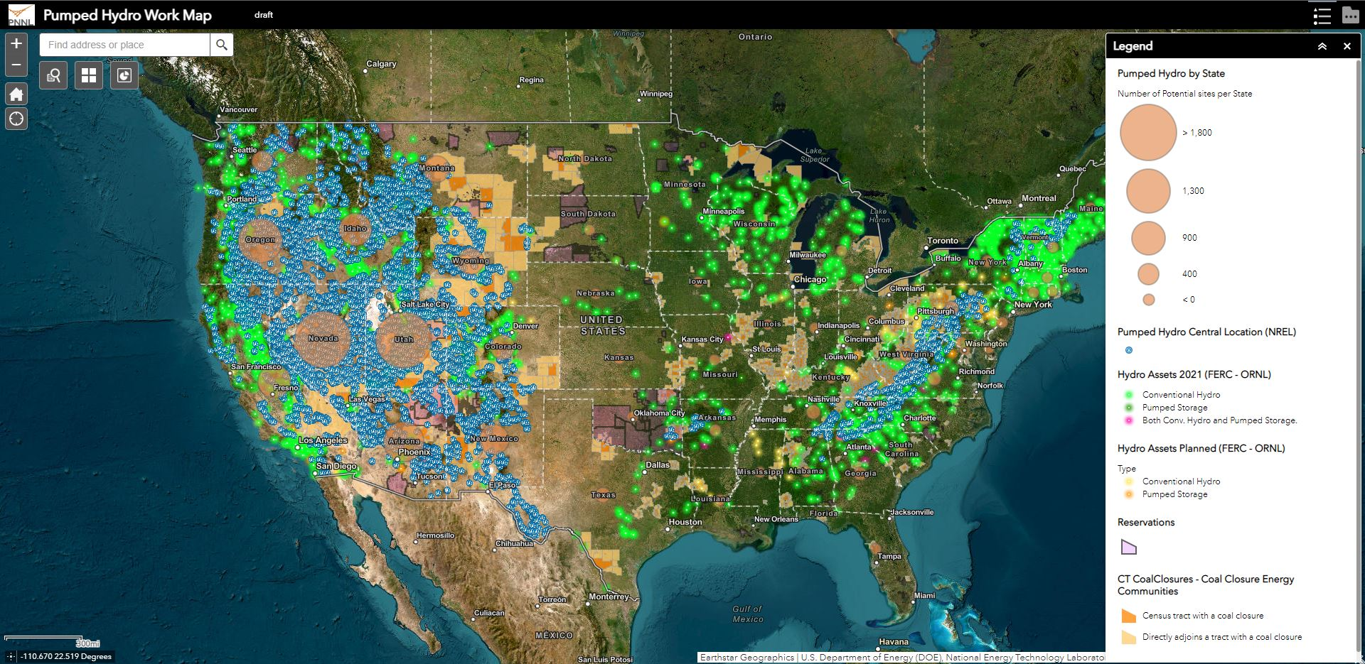
A Preview of the Forthcoming Tool
Notes:
The full picture brings these layers together to find high-potential PSH sites based on a combination of attributes, such as location with energy community and proximity to certain infrastructure like transmission.
Interestingly, the existing hydro assets layer can also help inform negative selection: unlikely to develop new PSH adjacent to an existing PSH facility.

Slide 10
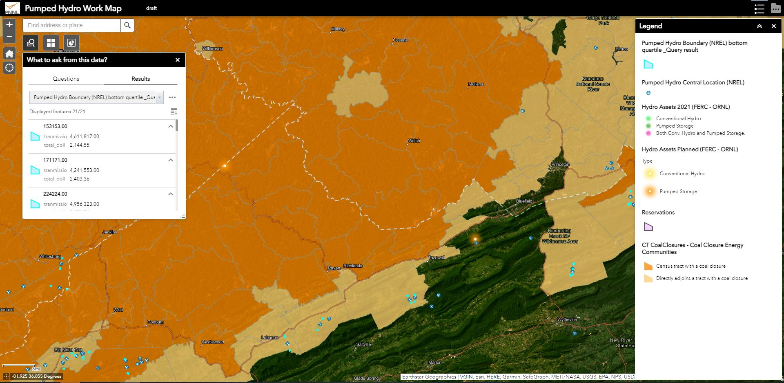
The Tool Will Include a Query Function
Notes:
There are 14,486 potential closed-loop PSH sites identified in the NREL layer for the United States. Our initial analysis suggests over 20% lie within the coal-closure energy communities as currently defined.
Query tool allows area selection and intersection search to filter which potential PSH sites are located within energy communities and other layers of interest.

Slide 11
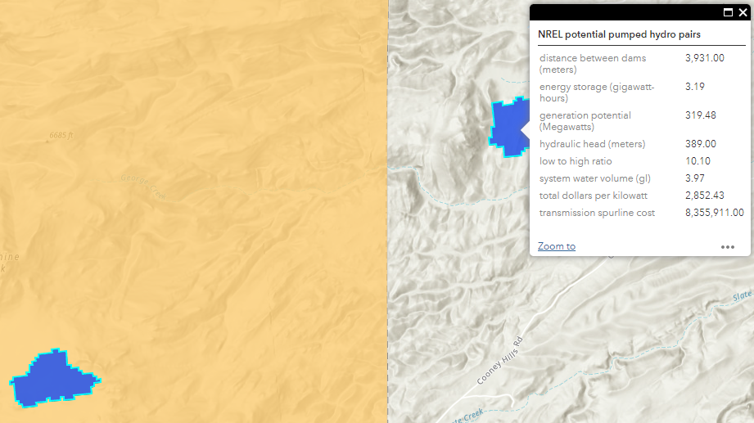
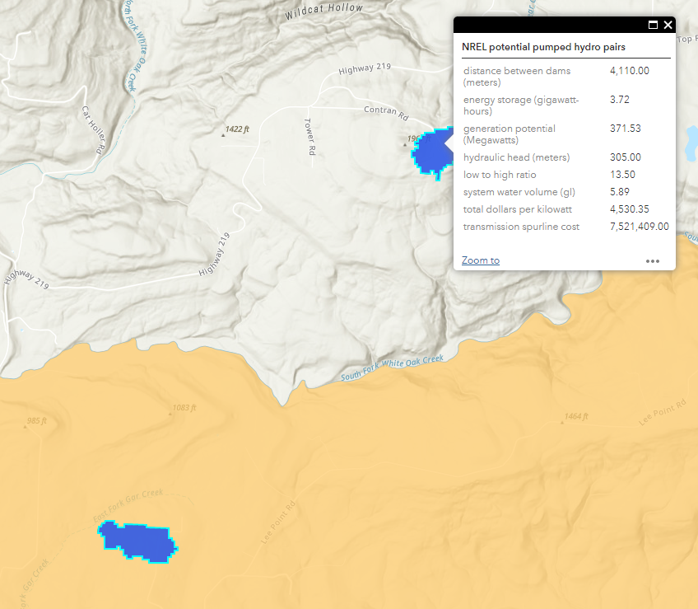
Tool Allows for Geospatial Assessment for Tax Credit Determination
Some potential PSH reservoir pairs straddle an energy community boundary. How does this affect tax credit determination?
Upper reservoir in Lower reservoir out
Lower reservoir in Upper reservoir out
Notes:
The tool illustrates special occurrences like these that might not be readily apparent without a geospatial view. The tool might also therefore be useful for informing policy.
Initial IRS guidance on energy community bonus offers nameplate capacity test and footprint test to determine if project lies within energy community.
“An EC [energy community] Project that has nameplate capacity must apply the Nameplate Capacity Test. An EC Project that has no nameplate capacity must apply the Footprint Test.”
Nameplate capacity test: “Under the Nameplate Capacity Test, an EC Project that has nameplate capacity is considered located in or placed in service within an energy community if 50 percent or more of the EC Project’s nameplate capacity is in an area that qualifies as an energy community”
“Nameplate capacity for an electrical generating unit means the maximum electrical generating output in megawatts (MW) that the unit is capable of producing on a steady state basis and during continuous operation under standard conditions, as measured by the manufacturer and consistent with the definition provided in 40 CFR § 96.202”
“For energy storage devices, the nameplate or maximum rated capacity means the storage device’s usable energy capacity (MWh). Usable energy capacity is the electric storage device capacity (in MW) multiplied by the duration hours of that storage capacity (h).”
Footprint test: “If an EC Project does not have a nameplate capacity (for example, qualified biogas property), such EC Project applies the Footprint Test. Such an EC Project is considered located in or placed in service within an energy community if 50 percent or more of its square footage is in an area that qualifies as an energy community.”

Slide 12
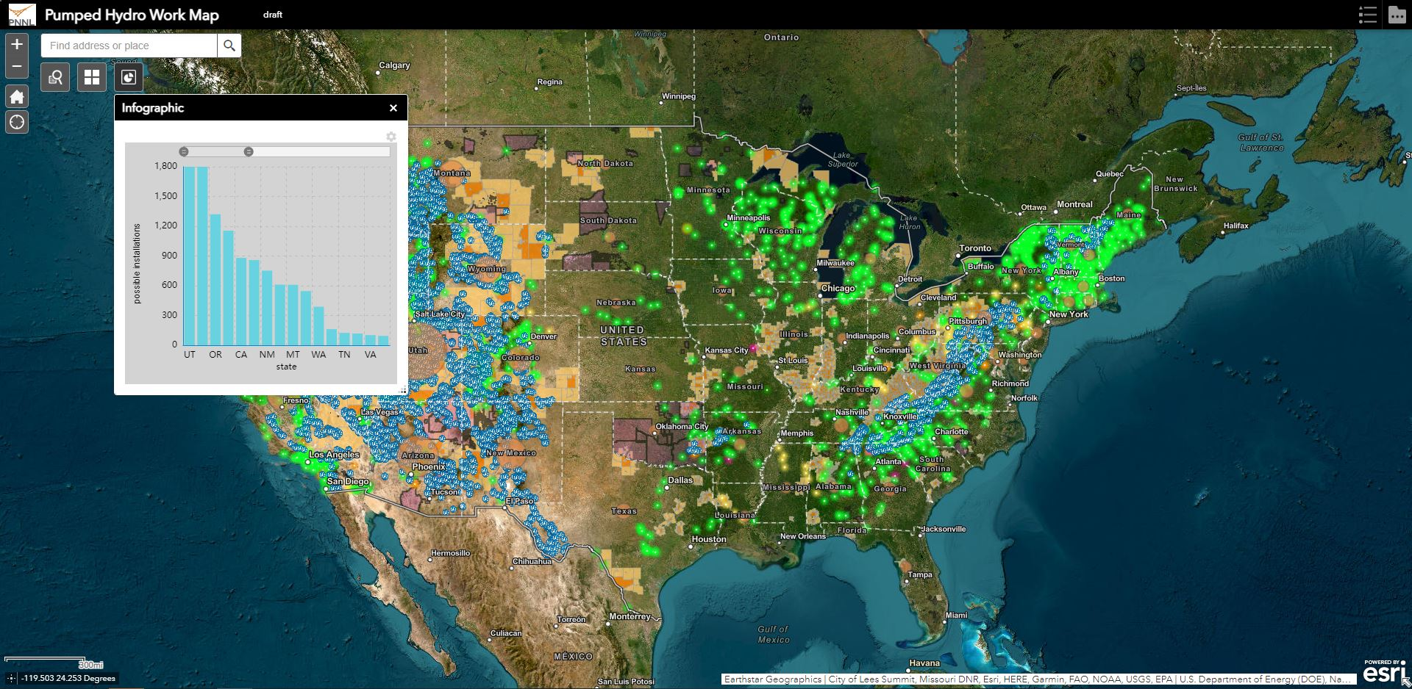
Users Will Be Able to View Potential Sites Summarized by State...

Slide 13
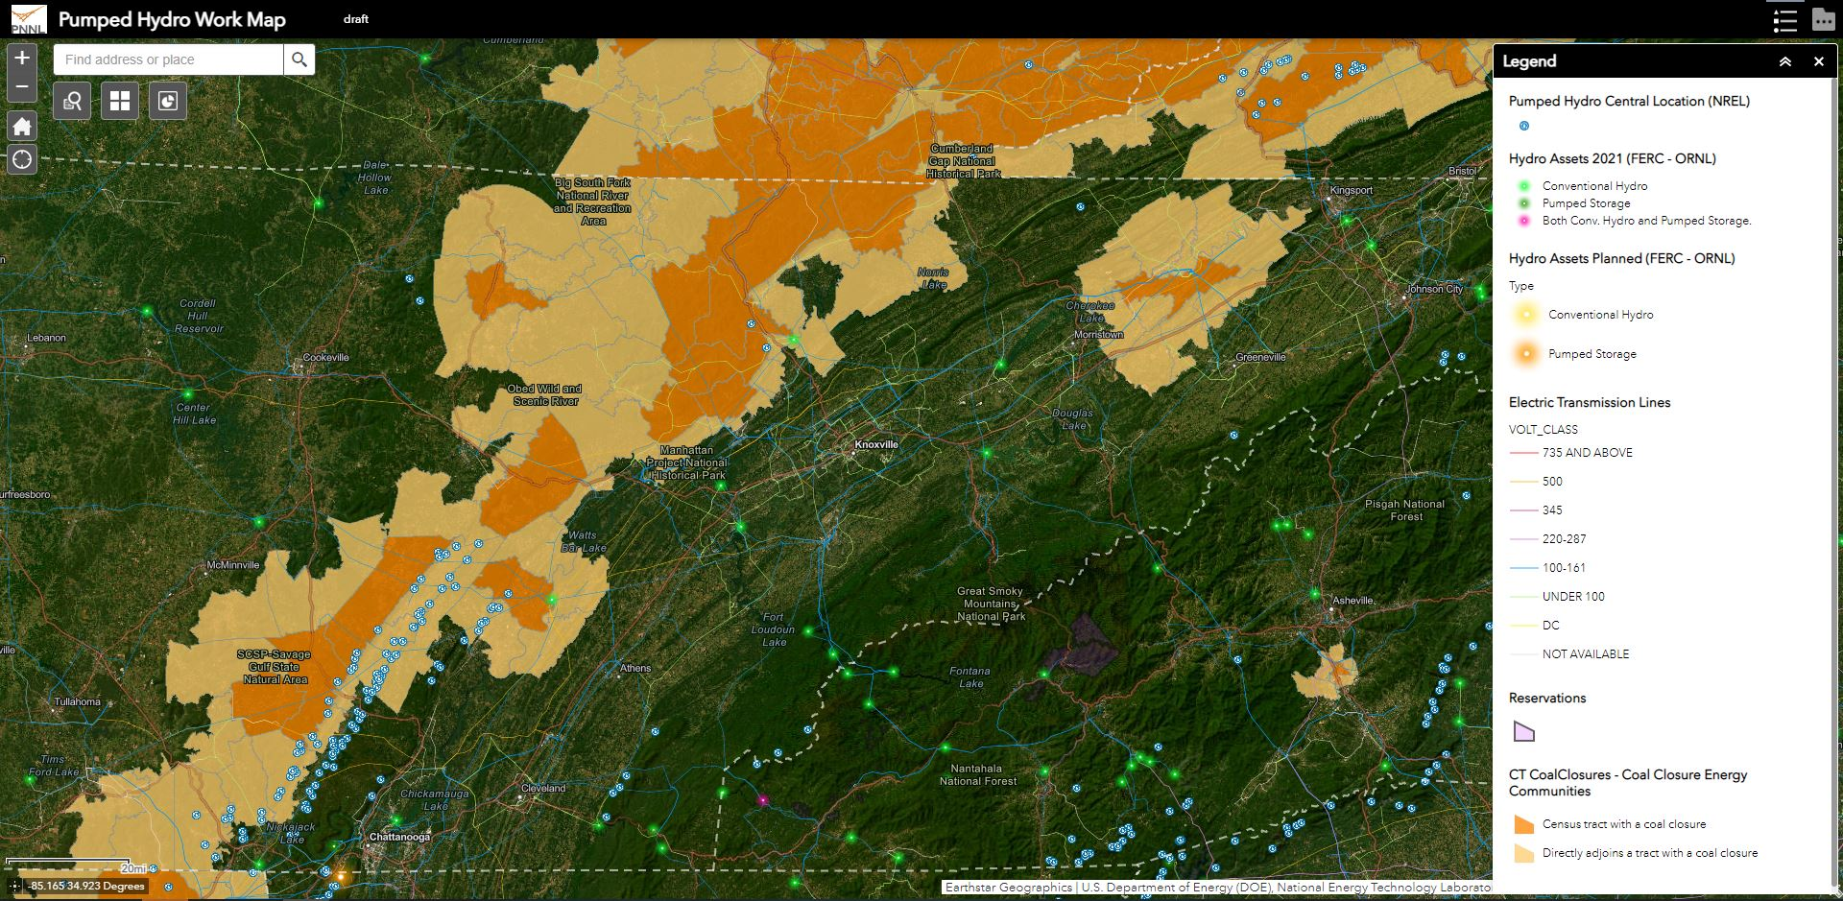
…Or Sites Across a Particular Region (Example: Appalachian Region)

Slide 14
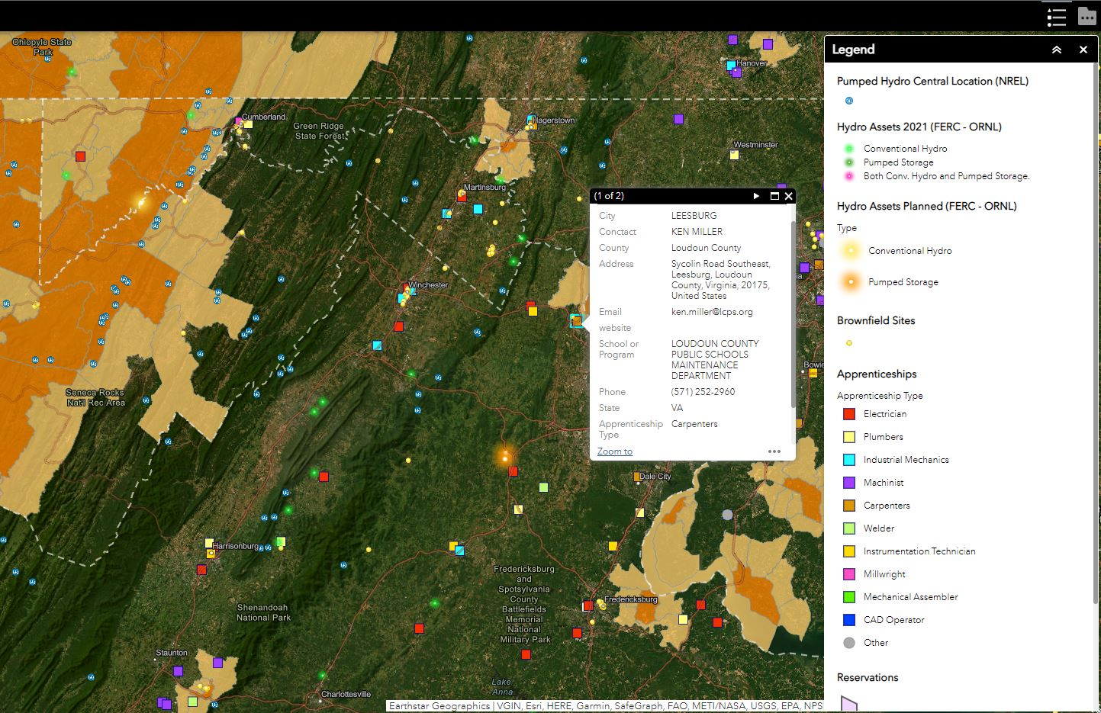
Users Can Also Find Apprenticeship Programs in the Region

Slide 15
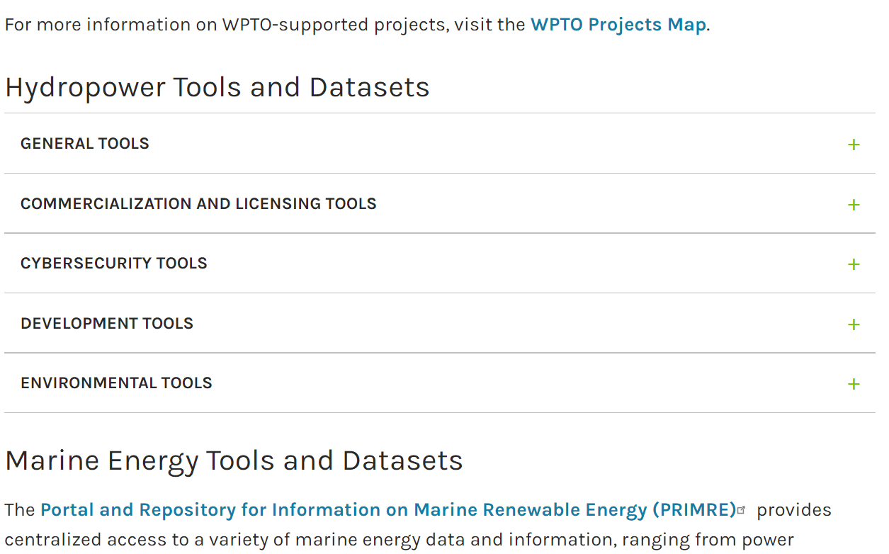
Discussion
WPTO has many other tools: Water Power Tools and Datasets | Department of Energy
What tools and analysis would be most useful to you?
How can we better collaborate going forward?
What projects are you most interested in building?

